Slide 1
Exploring Bike Segments in Idaho
Leo Bomboy, Nathan Nguyen, Andrew Plum, Noah Rieth, Anna Ronaye, Jonna Waage

Slide 2
Why We Chose the Strava Dataset
Goals
Learn what factors correlate with an athlete's choice of path
Investigate ride speed among athletes of varying experience/fitness
Reasons:
Richness of Data
Availability and Accessibility
Diverse Data Source
How the Data was Found and Managed:
Pulled via the Strava API
Relevant data was extracted and organized based on the research goals
2
Notes:
Richness of Data:
The Strava dataset provides a wealth of information such as GPS coordinates, timestamps, speeds, distances, elevation gains, and more. This rich data allows for detailed analysis and exploration of various factors related to athletic performance and activity.
Availability and Accessibility:
The Strava dataset is potentially publicly available or accessible through APIs, making it convenient for researchers to obtain and work with. This availability saves time and resources compared to collecting data from scratch.
Diverse Data Sources:
Strava collects data from a diverse range of athletes, routes, and activities. This diversity in data sources allows for a comprehensive analysis of how different factors, such as path characteristics and athlete attributes, influence athletic performance.
How the Dataset was Found and Managed:
Finding the Dataset:
The Strava dataset may have been found through official Strava APIs or public data repositories where Strava data is made available for research purposes.
Researchers may have also accessed the dataset through collaborations with Strava or by obtaining permission to use anonymized data for research.
Data Management:
Once obtained, the dataset was stored and managed in a secure database to ensure data integrity and privacy.
Data cleaning and preprocessing steps were conducted to handle missing values, outliers, and ensure consistency in data formats.
Relevant data subsets were extracted and organized based on the research goals, focusing on key variables such as path characteristics, athlete attributes, and ride speeds.

Slide 3
Methods of Discovery
Data Formats Used:
JSON converted to CSV
Metadata Standards/Conventions Applied:
Dublin Core Metadata Elements to organize data
Standardize Metadata enhanced data description
Method(s) of Discovery and Access:
Python API used to pull Strava data
Dublin Core Metadata Elements were created as the metadata standard for this dataset
Impact on Process:
Helped in organizing data and metadata
Hindered by the need to decide which data fields to focus for analysis
Overall facilitated data comprehension and analysis within the group
2

Slide 4
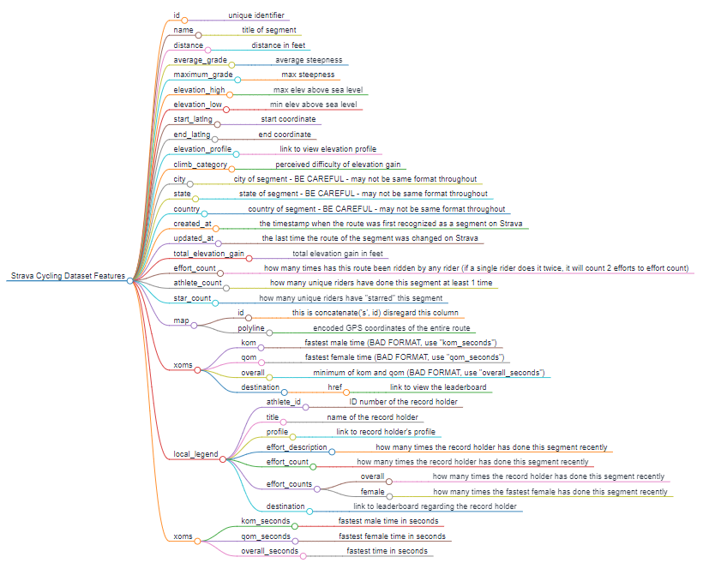
Mind Map Representation of Data Relatedness
2
Notes:
Regression Analysis:
Determine correlation between path characteristics and riding speed distributions.
Explore how path characteristics (e.g., elevation, age) impact ride speeds.
Path-Rider Correlation:
Apply rider characteristics (e.g., experience, fitness levels) to path difficulty.
Investigate performance differences based on path and rider characteristics.

Slide 5
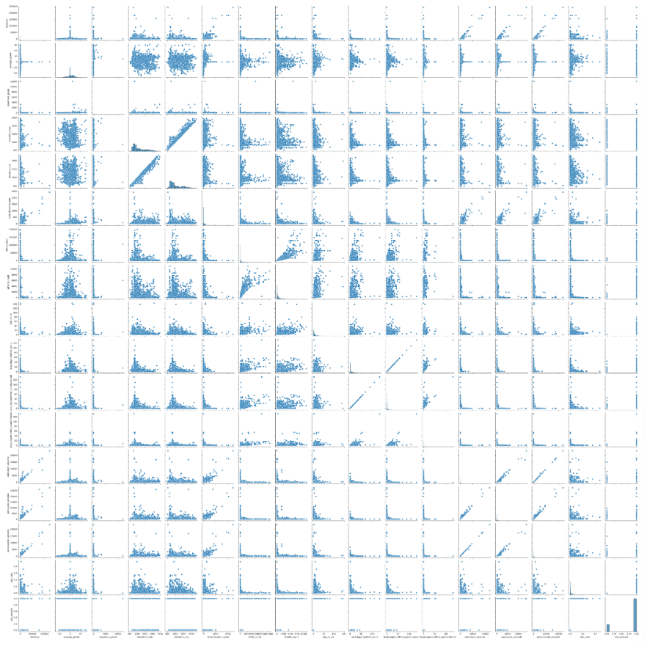
Initial Exploratory Visualization (1)
What trends exist in the data?
What questions can we ask?
2
Notes:
Regression Analysis:
Determine correlation between path characteristics and riding speed distributions.
Explore how path characteristics (e.g., elevation, age) impact ride speeds.
Path-Rider Correlation:
Apply rider characteristics (e.g., experience, fitness levels) to path difficulty.
Investigate performance differences based on path and rider characteristics.

Slide 6
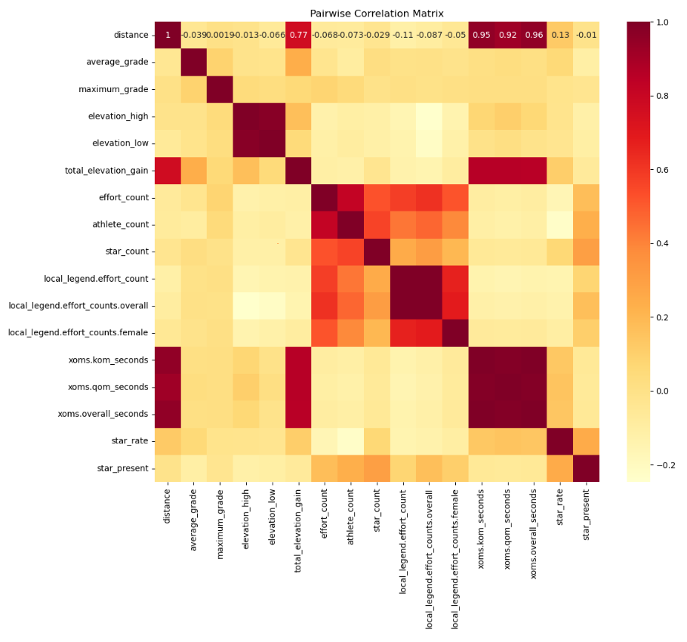
Initial Exploratory Visualization (2)
What trends exist in the data?
What questions can we ask?
2
Notes:
Regression Analysis:
Determine correlation between path characteristics and riding speed distributions.
Explore how path characteristics (e.g., elevation, age) impact ride speeds.
Path-Rider Correlation:
Apply rider characteristics (e.g., experience, fitness levels) to path difficulty.
Investigate performance differences based on path and rider characteristics.

Slide 7
Questions Related to Goal
Investigation Aim:
Explore what factors correlate with an athlete's choice of paths
Star count is a the data attribute that indicates how favored a trail is by athletes
Investigate ride speeds among athletes of varying experiences/fitness levels
Hypotheses:
The choice of paths taken by athletes are correlated with factors such as distance, average grade, maximum grade, elevation changes, and effort count
Path Characteristics (e.g elevation, age) will significantly influence ride speed irrespective of rider characteristics
Initial Analysis Approach:
Regression Analysis
2
Notes:
Regression Analysis:
Determine correlation between path characteristics and riding speed distributions.
Explore how path characteristics (e.g., elevation, age) impact ride speeds.
Path-Rider Correlation:
Apply rider characteristics (e.g., experience, fitness levels) to path difficulty.
Investigate performance differences based on path and rider characteristics.

Slide 8
Attack Plan of First Hypothesis
First Hypothesis:
Whether a trail is starred by athletes is correlated with factors such as distance, average grade, maximum grade, elevation changes, and effort count.
The API did not have data of whether an individual athlete starred a path
This means it needs to be derived
We did have a star count and an athlete count
So attributes star rate (star count / athlete count) and star present (0 if no stars for trail and 1 if trail has at least 1 star) were derived
The question could now be explored as a binary classification problem
This meant we could use logistic regression, KNN, SVM, binary neural network classifiers as our models
2
Notes:
Regression Analysis:
Determine correlation between path characteristics and riding speed distributions.
Explore how path characteristics (e.g., elevation, age) impact ride speeds.
Path-Rider Correlation:
Apply rider characteristics (e.g., experience, fitness levels) to path difficulty.
Investigate performance differences based on path and rider characteristics.

Slide 9
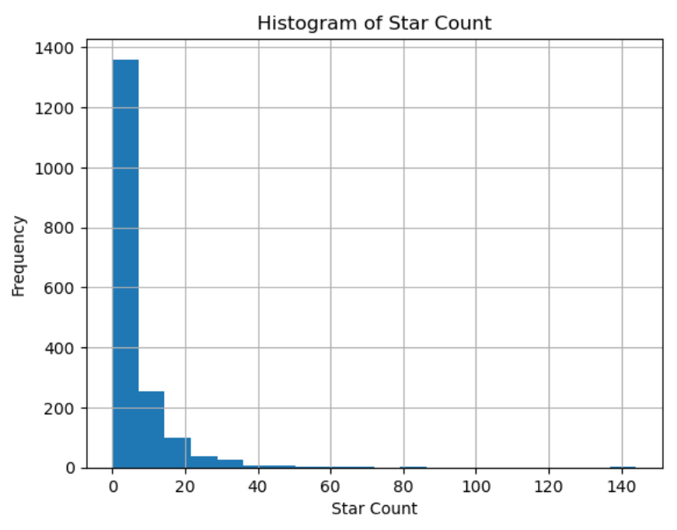
First Hypothesis Related Visualization (1)
2
Notes:
Regression Analysis:
Determine correlation between path characteristics and riding speed distributions.
Explore how path characteristics (e.g., elevation, age) impact ride speeds.
Path-Rider Correlation:
Apply rider characteristics (e.g., experience, fitness levels) to path difficulty.
Investigate performance differences based on path and rider characteristics.

Slide 10
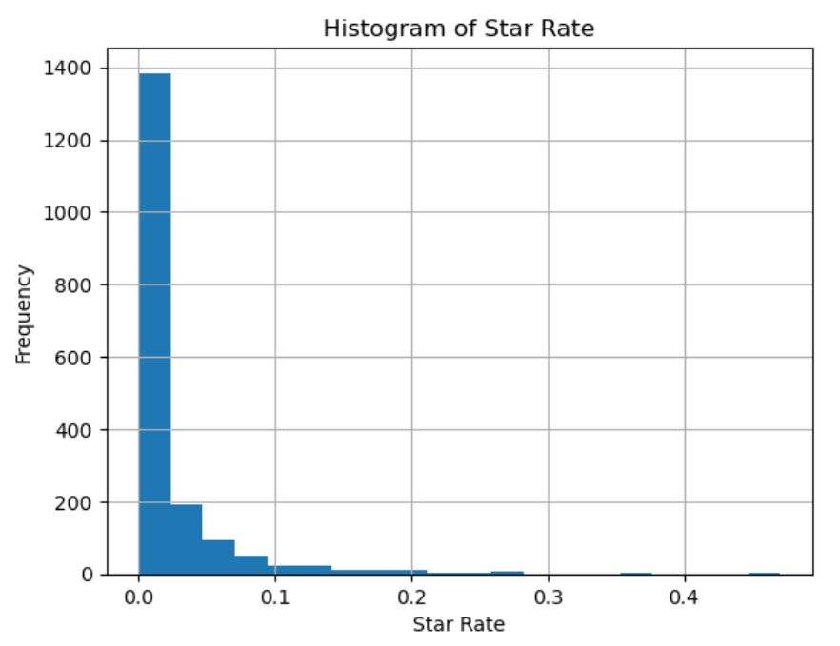
First Hypothesis Related Visualization (2)
2
Notes:
Regression Analysis:
Determine correlation between path characteristics and riding speed distributions.
Explore how path characteristics (e.g., elevation, age) impact ride speeds.
Path-Rider Correlation:
Apply rider characteristics (e.g., experience, fitness levels) to path difficulty.
Investigate performance differences based on path and rider characteristics.

Slide 11
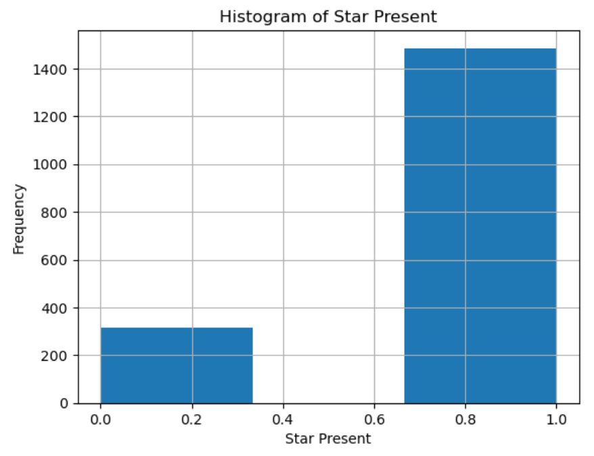
First Hypothesis Related Visualization (3)
2
Notes:
Regression Analysis:
Determine correlation between path characteristics and riding speed distributions.
Explore how path characteristics (e.g., elevation, age) impact ride speeds.
Path-Rider Correlation:
Apply rider characteristics (e.g., experience, fitness levels) to path difficulty.
Investigate performance differences based on path and rider characteristics.

Slide 12
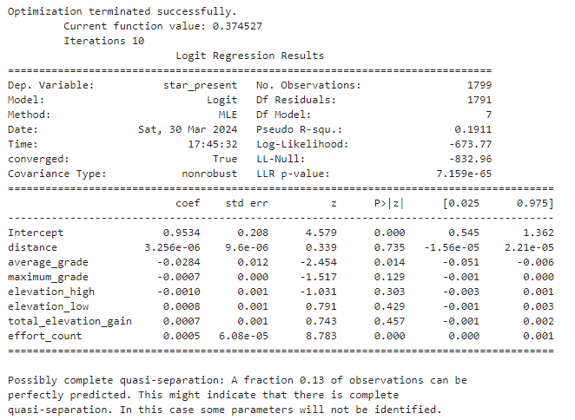
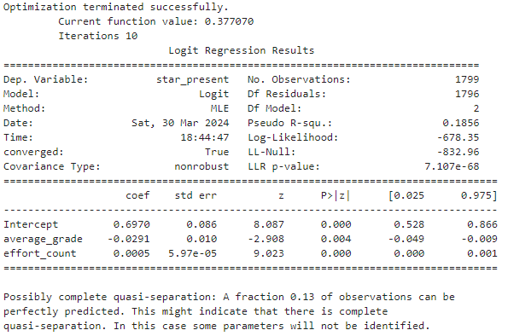
Logistic Regression Results
First Logit Model
Second Logit Model
2

Slide 13

Going Forward
Utilize binary classification models alongside.
K-nearest-neighbor
Support vector machines
Binary neural network classifier
2

Slide 14
Overall Data Management Plan
Creation of Logical Collections
- Two collections based on the two hypothesized questions will exist. With two databases, analysis can be easier due to split research goals.
Physical Data Handling
- Raw data as well as the two databases (CSVs) will be stored in the Google Drive Cloud Environment. Allowing for enhanced security, availability, and easier custodianship.
2

Slide 15
Overall Data Management Plan Cont.
Interoperability Support
- Data collected from the Strava API will be thoroughly investigated to ensure compatibility with our open source analysis tools. Which will mostly consist of Google Drive, Visual Studio, and other open source office software programs.
Security Support
- Robust measures such as cloud storage, in transit/at rest encryption, and access controls will be implemented. This allows our data to have sufficient confidentiality, integrity, and security.
2

Slide 16
Overall Data Management Plan Cont.
Data Ownership
- Responsibility for the data will be based upon roles assigned to group members. To ensure a chain of custody going forwards.
Metadata Collection, Management, and Access
- Collected metadata consisting of rider and path information will be stored in the cloud. This will also allow authorized individuals and stakeholders to access data organized according to the Dublin Core for Metadata Standards.
2

Slide 17
Overall Data Management Plan Cont.
Persistence
- Google Drive allows for high persistence, with our databases existing in several high availability locations at once.
Discovery
- As data is ingested, it will be thoroughly integrated into the metadata standards mentioned. Categorization allows for quicker analysis and referencing.
2

Slide 18
Overall Data Management Plan Cont.
Data Dissemination and Publication
- During the project, distribution of the dataset will only occur within the team and with our supervisors. After which data will be uploaded to an open source research base such as Github.
2

